Slide 1
Customer Segmentation and Products Recommendation Engine on Brazilian Ecommerce DataSet
By
Srikaran Elakurthy, Avinash Yavvari

Slide 2
DataSet Description
Dataset is extracted from olist store in brazil
It consists of 100k orders from 2016 to 2018
It consists of 9 files
Customers dataset
Geological Dataset
Order Items dataset
Payments dataset
Order Reviews dataset
Orders dataset
Products dataset
Sellers Dataset
Product Category name translation

Slide 3
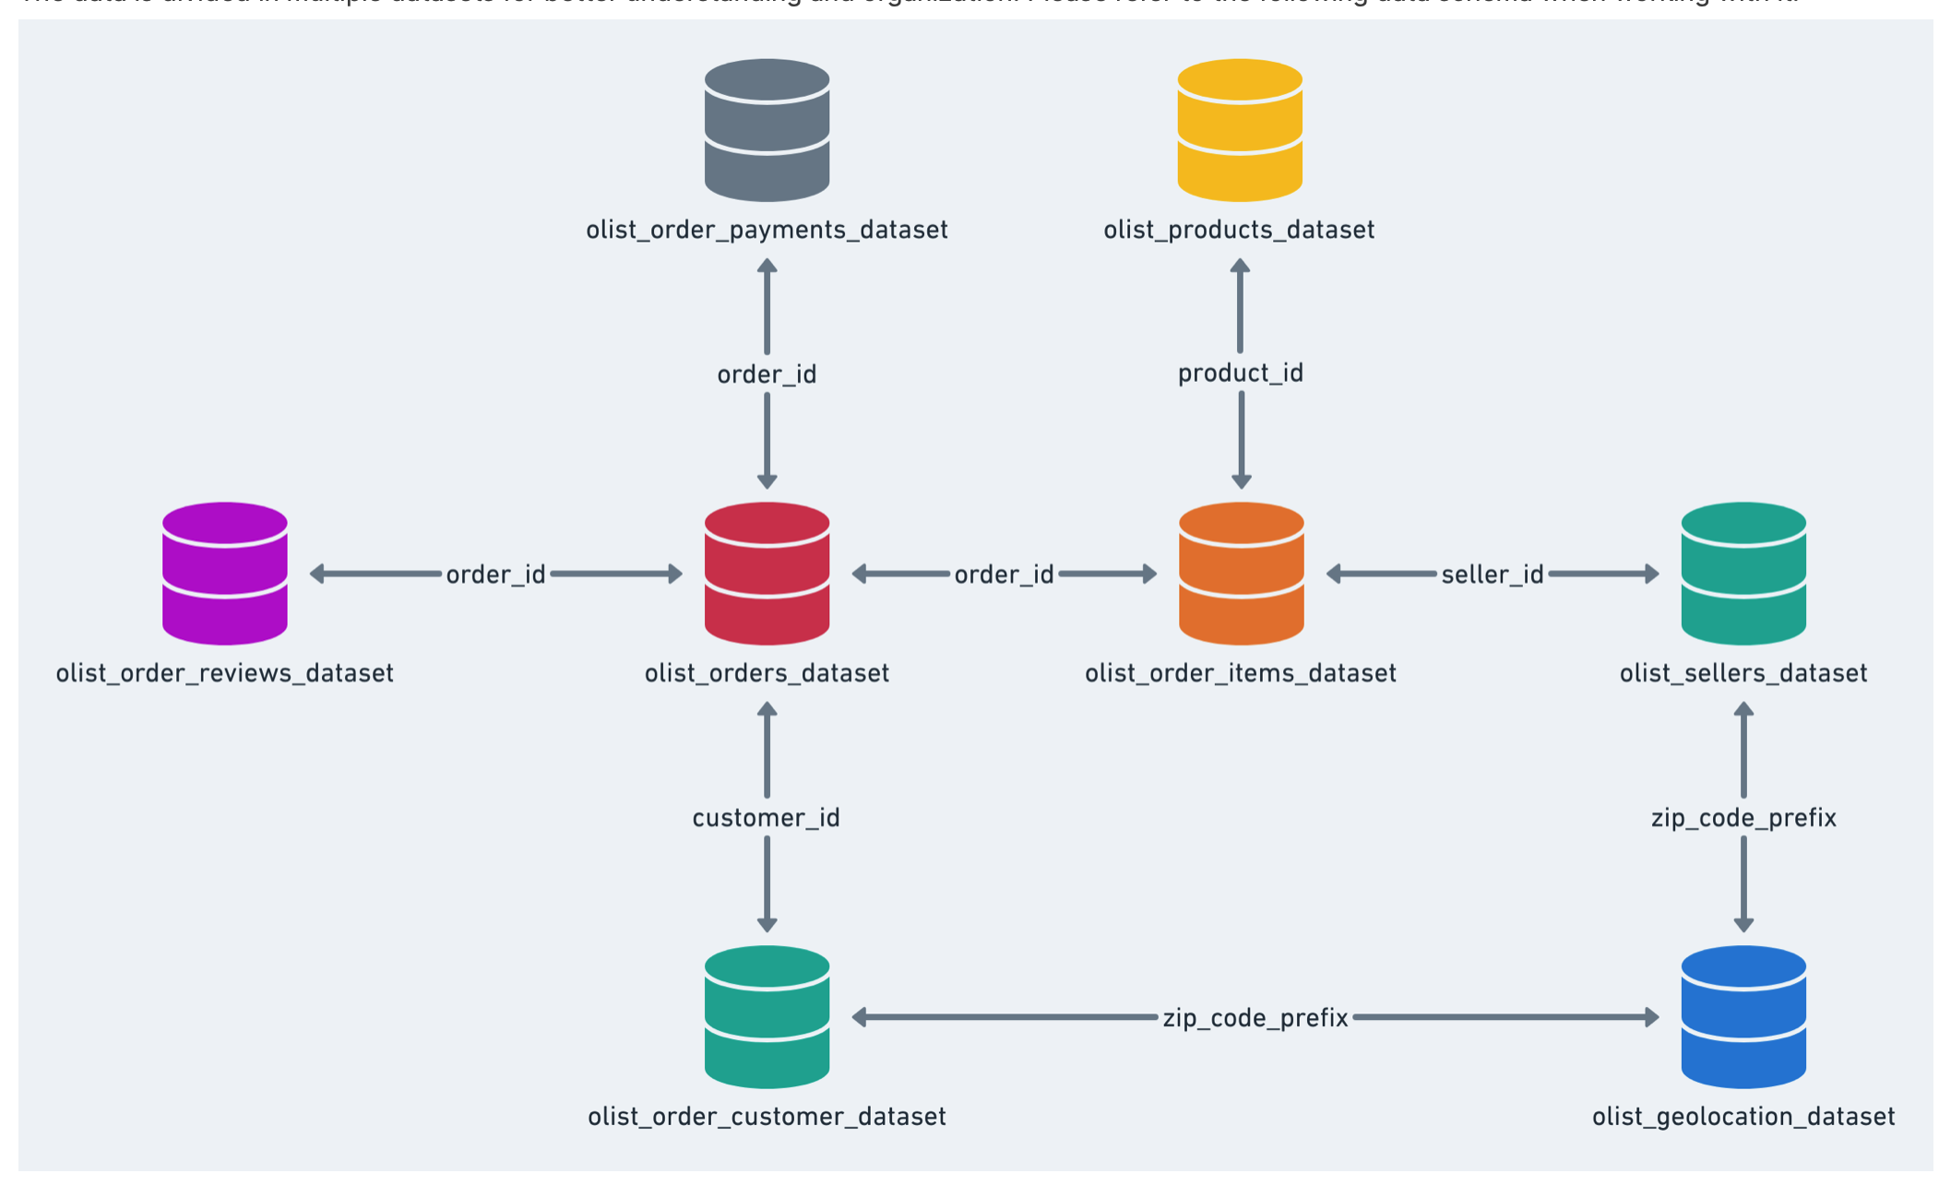

Slide 4


Data preprocessing
Customers ,orders, sellers , Product category name ,Geological and order items dataset has no missing values.
In payments dataset Payment type feature has 7% of missing value and we are replacing with the mode.
In reviews dataset review title has around 80% of missing values so we are removing the columns and reviews comments has around 50% of data missing and replaced with word ‘Noinformation’.
In products dataset , product length and product width has around 4% values are missing.

Slide 5
Text Preprocessing
As our reviews dataset we had text data so we removed the following things:
Emojis
Html tags
Special characters except exclamation mark
Then we perform stemming
Then we performed POS tagging.

Slide 6
System Architecture
16 V Cpu 30GB Ram
Gpu: Nvidia Tesla V100
Hive
Spark
Tableau and R

Slide 7

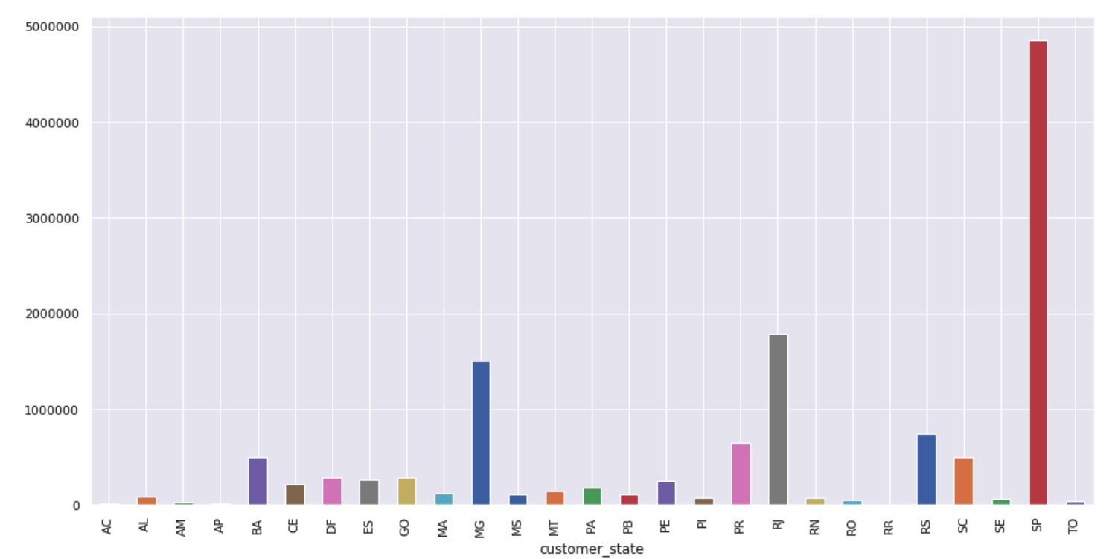
Customers Living in States

Slide 8
Payment Type

Slide 9
Objectives
Forming a rich dataset by integrating the data from different files which can be used in modeling the customer segmentation.
Performing customer segmentation to create a cluster of customers specifying what are there interests on products for each group.
Analyzing which products are more interested and prone to get selled.
Analyzing the patterns of the clusters and find the valuable insights which would be helpful in increase of business market.
Recommendation of products per customer by considering reviews, geological distance and previous purchases and using the previous clustering information.

Slide 10
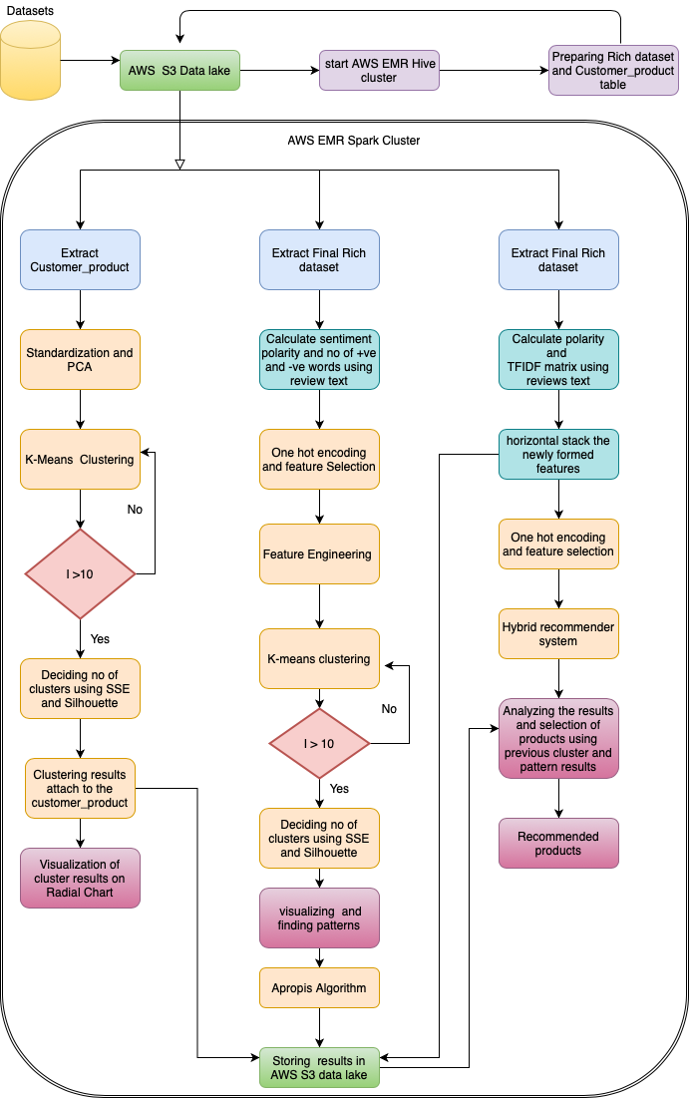

Slide 11
Model -1

Slide 12
Customer Product Table

Slide 13
K means Clustering
We used kmeans as our clustering method.
Find out the optimal number of clusters as 3 by using silhouette method.

Slide 14
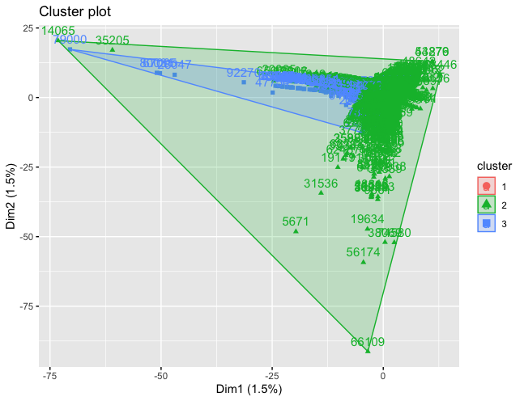

Slide 16
Model-2

Slide 17
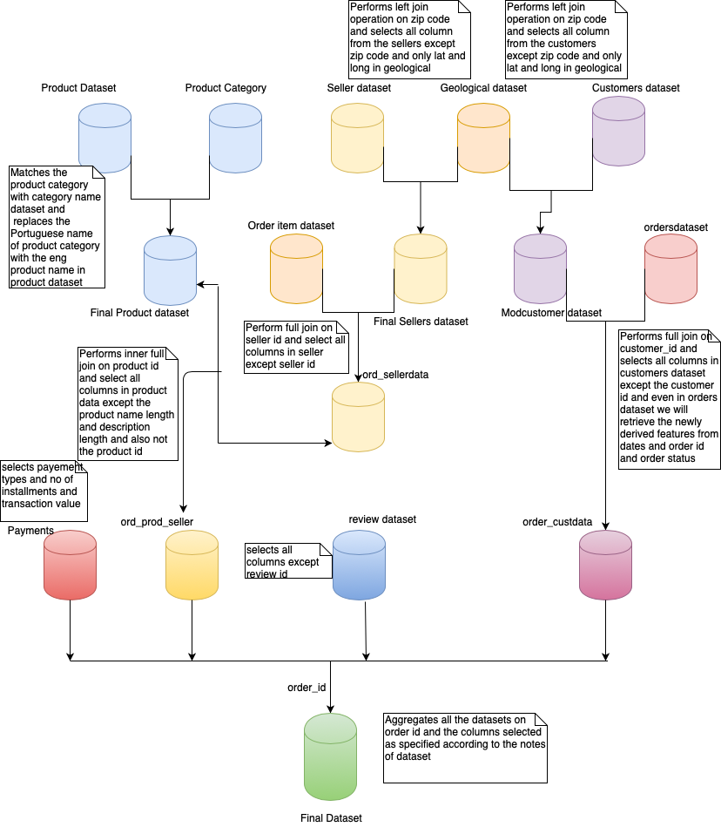
Preperation of Rich Dataset

Slide 18
Feature Extraction
Is_latedelivered: if it is a late delivery will have value 0 and if it’s not value will be 1.
No_of latedeliverydays: If it’s not a late delivery the number of days the ordered delivered late is 0 otherwise it will be the negative .
Distance: calculate the distance between customer and seller.
Polarity_of_review_text: By analyzing the review description and review title and will be making an sentiment analysis from it whether it is a positive polarity or negative polarity.
No_of _Positive_words: Will calculate the no of positive words in each review.
No_of _negative_words: Will calculate the no of negative words in each review

Slide 19
Feature Engineering:
Converted text data into TF-IDF matrix using Ngram range (1,2) and stop_words=English.
Converting Text data to POS tagging .
Then we perform Normalization on Pos Tagging.
We pass the text data and find the sentiment polarity and positive words using Text blob library.
Then we horizontally stack the tfidf matrix and pos tagging with the Rich dataset and removing the reviews.
Then we perform one hot encoding on categorical variables such as Payment Type.
Then we perform PCA analysis to reduce the dimensions.

Slide 20
Storing into S3 data lake
The obtained dataset is again stored into S3 with name Proceesed_rich dataset

Slide 21
KmeanS clustering
Performing kmeans clusterinng method in our prepared rich final dataset.
We are still tuning the clustering technique and we will find the optimal number of clusters using SSE and Silhoutte method.
Cluster label is given to whole dataset.
Then by using Customer unique id and label the cluster id with rich dataset.
The result of dataset is given to Apriori algorithm and find the rules which are stored into S3.

Slide 22

Model 3

Slide 23
Product Recommender Model
We will extract the processed rich data set from S3
We will pass the data into hybrid recommeder model which we will use from Sklearn library.
Our output will be the Product category’s and the pattern for a customer unique id.

Slide 24
Final Product Recommendation System

Slide 25

Related Work
Many Papers have worked on Customer Segmentation and finding customer behavior using PAM models and K means considering only numerical data.
Many papers worked on marketing analytics and sales correlations .

Slide 26
New things in Project
Considering Text data in Clustering analysis.
Preparing 2 cluster models and integrating the results.
Considering the distance between sellers and customers using zipcodes.
Applying Apriori rules on Clustered data and use this for recommender model.
Preparing a recommender system with hybrid model and clustering results.

Slide 27

Thank You

